Slide 1
Neural Networks All of Neural Networks in One Class!
Dealing with Data, Class 7

Slide 2
Announcements
We’ll get you feedback on your project proposals soon!
Next time: Short presentations!
Keep them under 5 minutes!
See project guideline document for more!

Slide 3
Agenda
Recap
Neural Networks
What’s the model?
How do we fit the model?
What assumptions does the model impose on the world?
How do we interpret the model once it’s fit?
Detour: Optimization!
Detour: Overparameterization!
Note: The goal is not to make you an expert in neural networks in one day!
Instead:
Give you the basic idea
Highlight some open research directions
Highlight how we can/can’t use ML tools for (causal) interpretation

Slide 4
Recap

Slide 5
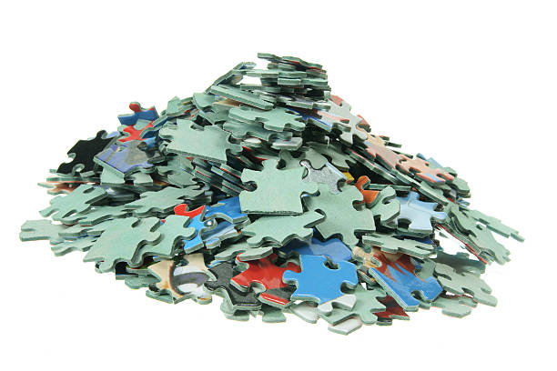
Models
Structure that we impose on the world.
All models are wrong, but some are useful.
Class 5! Regression = “fitting a linear model”
Low-degree models
Neural
networks
...
“The universe is a uniform void.”
Linear models
“Chaos! We can’t do anything!”
Sparse/Low-rank models
Universe
Simple
Complex

Slide 6
Models
Structure that we impose on the world.
All models are wrong, but some are useful.
Class 6! PCA/SVD = “fitting a “low-rank” model”
Low-degree models
Neural networks
...
“The universe is a uniform void.”
Linear models
“Chaos! We can’t do anything!”
Sparse/Low-rank models
Universe
Simple
Complex

Slide 7
Models
Structure that we impose on the world.
All models are wrong, but some are useful.
Today!
Low-degree models
Neural
networks
...
“The universe is a uniform void.”
Linear models
“Chaos! We can’t do anything!”
Sparse/Low-rank models
Universe
Simple
Complex

Slide 8
Neural Networks

Slide 9
Neural Networks are a model
We need to answer:
What is the model?
How do we fit the model?
When is it reasonable? What assumptions does it impose?
How do we interpret the model once it is fit?

Slide 10
What is a neural network?
Modern neural network architectures are pretty complicated
Recurrent NNs
“Transformers” / “Attention”
...
Today we’ll just do the basics
(Multi-layer) feed-forward neural networks
This captures the basic idea – take an ML class for more!

Slide 11
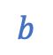
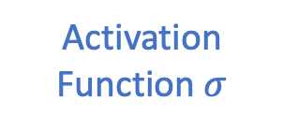
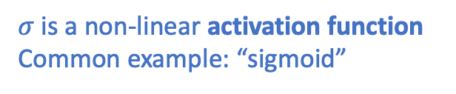


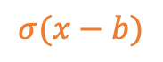

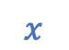
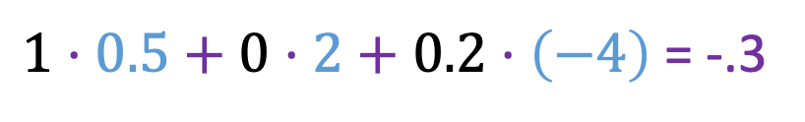
Building Block: Neuron
$$1$$
$$σ(x−b)$$
$$x$$
$$b$$
1
$σ$ is a non-linear activation function
Common example: “sigmoid”
0.5
2
$$σ$$
0
0.1
-4
Output
Activation Function $σ$
.2
[with shift “b”]
$1⋅0.5+0⋅2+0.2⋅\left(−4\right)$ = -.3
Weights
Output = $σ( −0.3)$
Inputs
(say b=0 here)

Slide 12
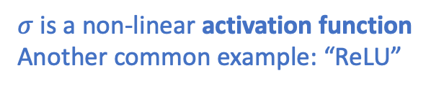
Building Block: Neuron
$$σ(x−b)$$
$$x$$
$$b$$
1
$σ$ is a non-linear activation function
Another common example: “ReLU”
0.5
2
$$σ$$
0
0
-4
Output
Activation Function $σ$
.2
[with shift “b”]
$1⋅0.5+0⋅2+0.2⋅\left(−4\right)$ = -.3
Weights
Output = $σ( −0.3)$
Inputs
(say b=0 here)

Slide 13
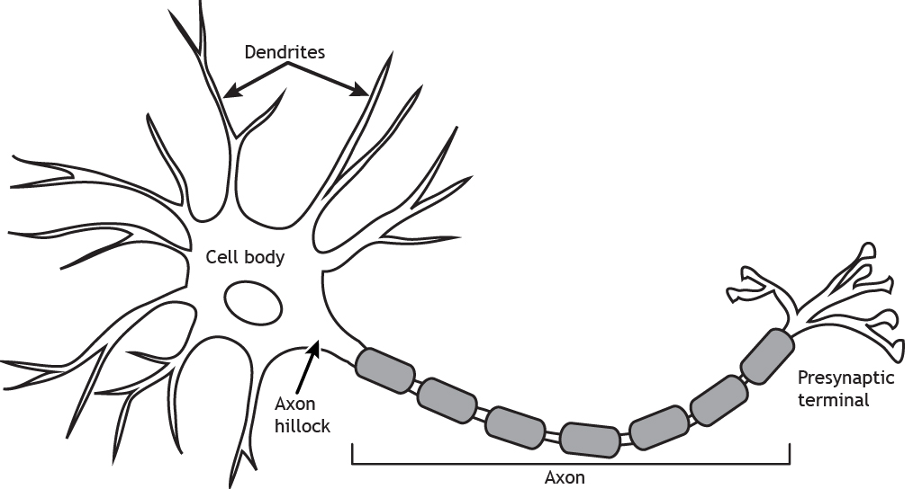
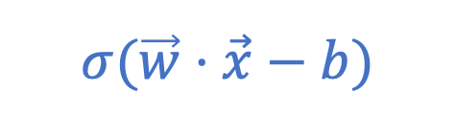
Why is this called a “neuron”?
The model originated (in the 1940’s/1950’s) as a model for actual neurons.
1
0
Output
Inputs
0.1
$$σ(\vec{w}⋅\vec{x}−b)$$
0.2

Slide 14


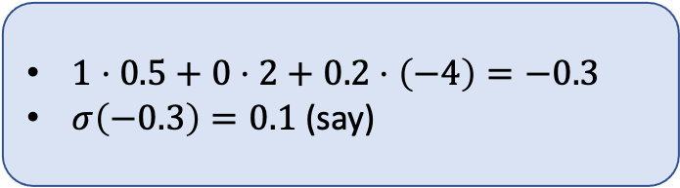

Neural Network: Network of Neurons
$1⋅0.5+0⋅2+0.2⋅\left(−4\right)=−0.3$
$σ\left(−0.3\right)=0.1$ (say)
1
0.5
$$σ$$
2
0.1
-1
0
$$σ$$
-4
3
Output
.2
$$σ$$
2.2
.2
-.2
Inputs

Slide 15
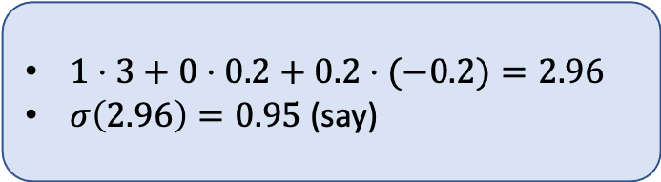
Neural Network: Network of Neurons
1
0.5
$$σ$$
2
0.1
-1
0
$$σ$$
-4
3
Output
.2
$$σ$$
2.2
0.95
.2
-.2
$1⋅3+0⋅0.2+0.2⋅(−0.2)=2.96$
$σ\left(2.96\right)=0.95$ (say)
Inputs

Slide 16
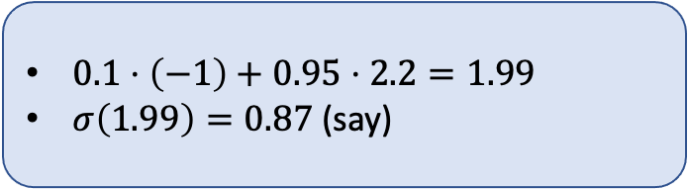
Neural Network: Network of Neurons
1
0.5
$0.1⋅\left(−1\right)+0.95⋅2.2=1.99$
$σ\left(1.99\right)=0.87$(say)
$$σ$$
2
0.1
-1
0
$$σ$$
-4
0.87
3
Output
.2
$$σ$$
2.2
0.95
.2
-.2
Inputs

Slide 17
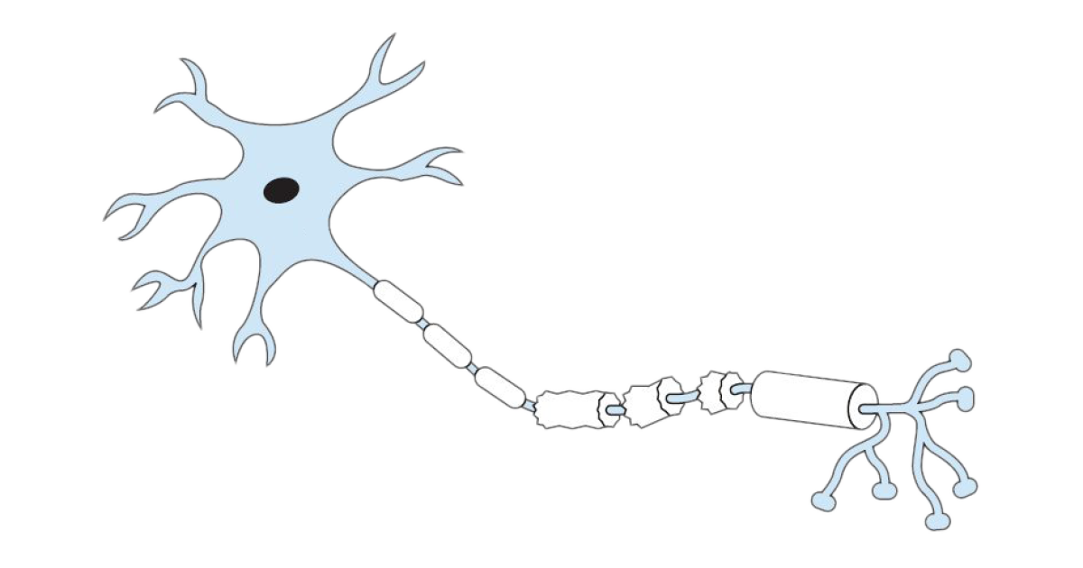



Neural Network: Network of Neurons
1
0.5
$$σ$$
2
0.1
0
-1
$$σ$$
0.87
-4
3
Output
.2
$$σ$$
2.2
.2
0.95
-.2
Inputs
1
0.1
0.87
Output
0
0.95
.2
Inputs

Slide 18























(Feed-Forward) Neural Networks
Note: there are other “topologies” possible. Take an ML class!
$$σ$$
$$σ$$
$$σ$$
$$σ$$
$$σ$$
$$σ$$
$$σ$$
$$σ$$
$$σ$$
$$σ$$
$$σ$$
$$σ$$
$$σ$$
$$σ$$
$$σ$$
$$σ$$
Output(s)
$$σ$$
$$σ$$
$$σ$$
$$σ$$
$$σ$$
$$σ$$
$$σ$$
Inputs
First “hidden” layer
Second “hidden” layer
Etc.

Slide 19
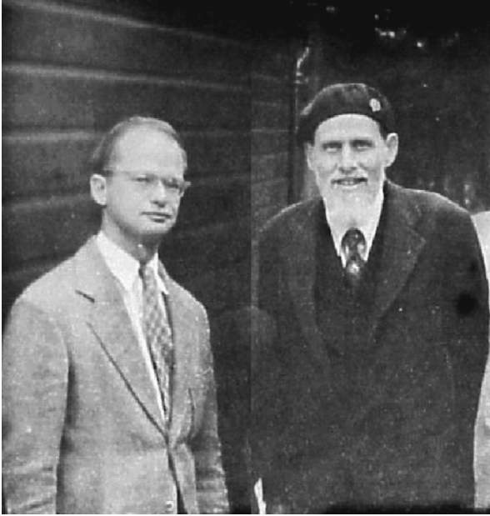
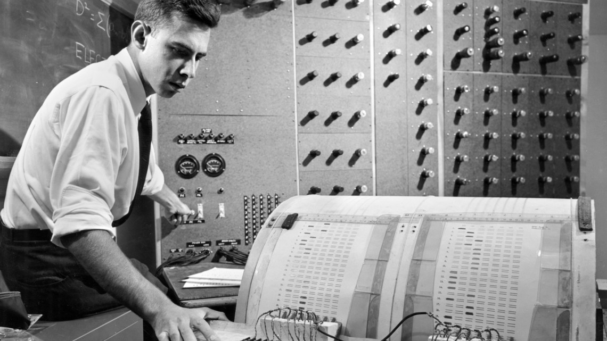
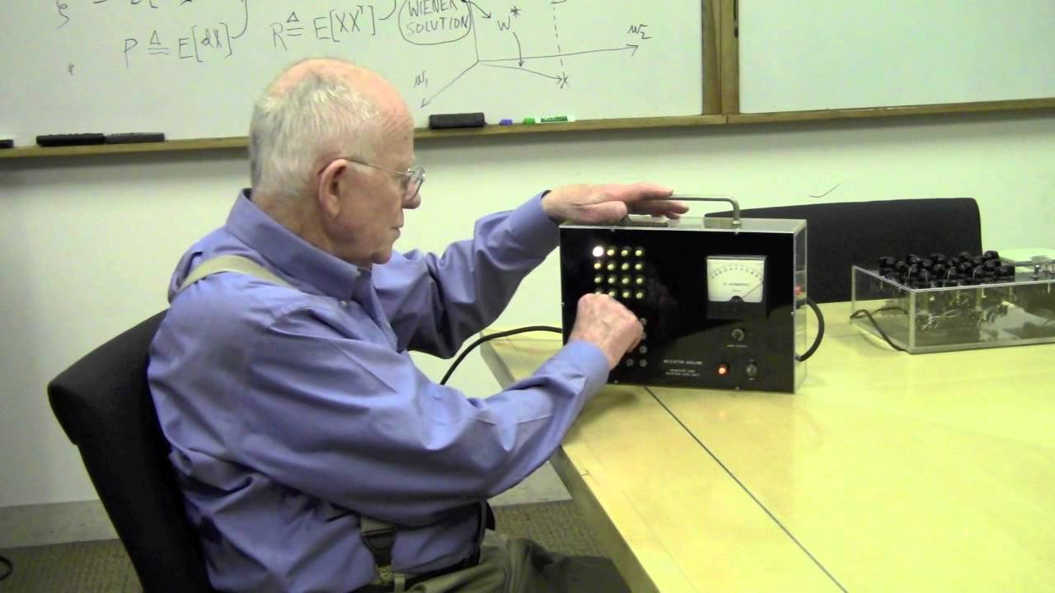
Brief History
McCulloch (neurophysiologist) and Pitts (mathematician)
This model of a neuron goes back to McCulloch-Pitts (1943)
Hebb (1948) and Rosenblatt (1958) had ideas about how single neurons “learn” the weights.
Widrow and Hoff (1960) built ADALINE, which “learned” to eliminate noise in phone lines.
Minsky and Papert (1969) wrote a book “Perceptrons” arguing that single neurons are not the way to go...
Rosenblatt (psychologist) and his “Perceptron”
Widrow (electrical engineer) demonstrates ADALINE

Slide 20
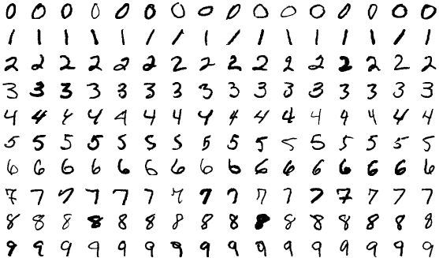
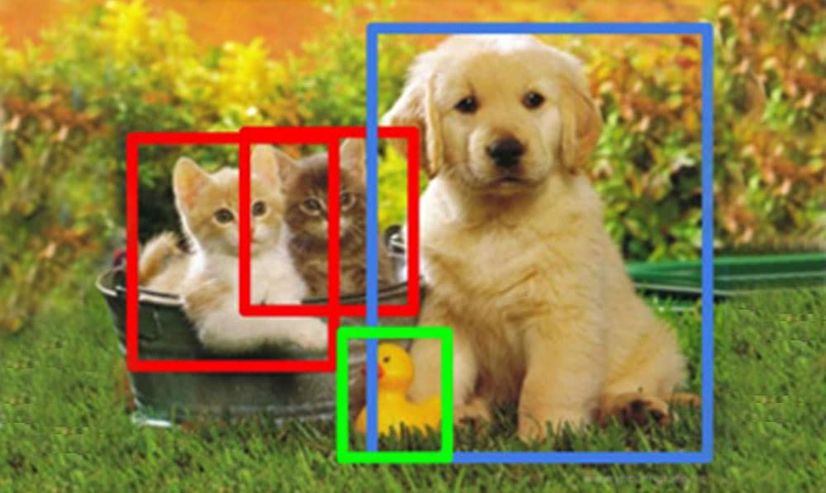


Brief History Continued
Early NNs were good at, e.g., handwriting recognition
[stall for a decade or so]
1982: Hopfield introduces what’s now called a “Hopfield Net,” a kind of neural network.
1980’s, 1990’s: researchers discover (and re-discover) ways to build and train multi-layer neural networks that actually work.
2010-ish: GPUs enter the picture and “deep learning” really takes off
2010’s-today: (Lots of progress, take an ML class...)
The future:
Image classification, object detection, etc.
Generative AI, e.g. DALL-E and ChatGPT
all hail our robot overlords?

Slide 21
Neural Networks model the world
We need to answer:
What is the model?
How do we fit the model?
When is it reasonable? What assumptions does it impose?
How do we interpret the model once it is fit?
Network of neuroscience-inspired “neurons”, with weights and thresholds “b”

Slide 22


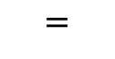
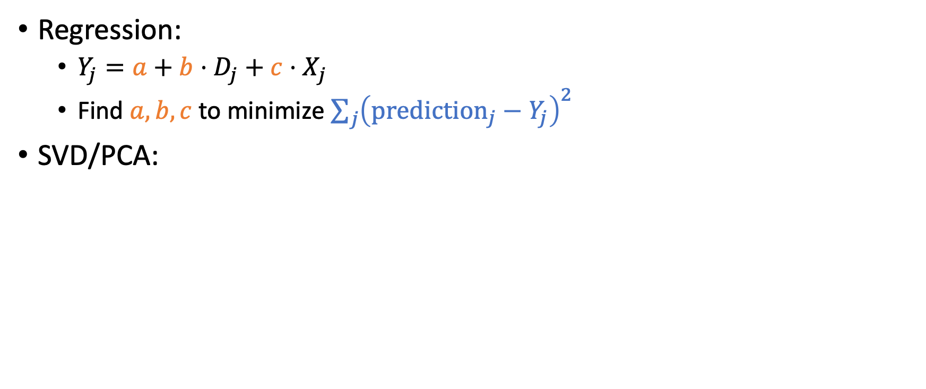
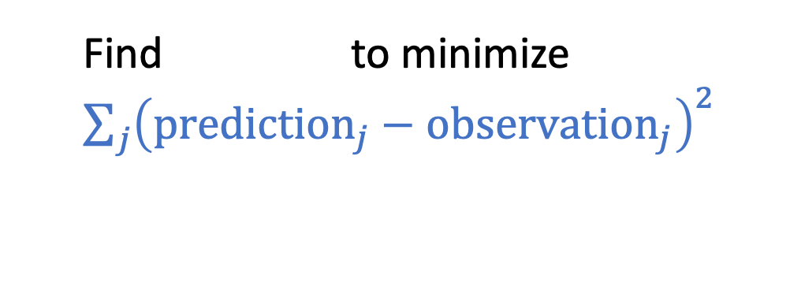
How have we fit previous models?
Regression:
$Y_{j}=a+b⋅D_{j}+c⋅X_{j}$
Find $a,b,c$ to minimize $\sum_{j}{{\left(prediction_{j}−Y_{j}\right)}^{2}}$
SVD/PCA:
Observed
prefs
Find to minimize $\sum_{j}{{\left(prediction_{j}−{observation}_{j}\right)}^{2}}$
$$=$$

Slide 23
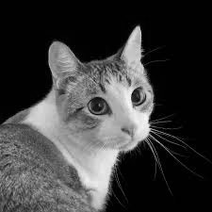

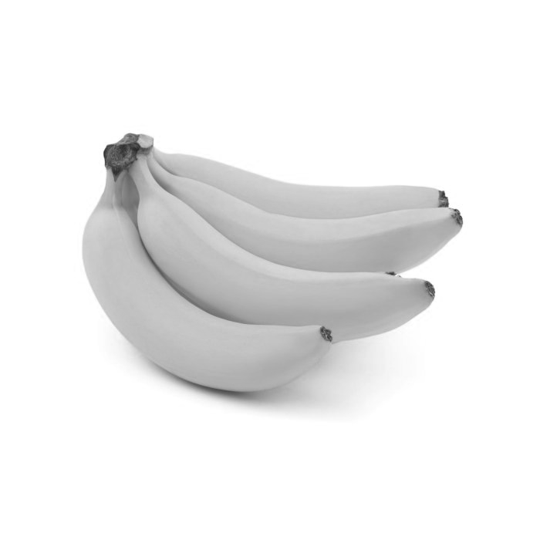
How do we fit a neural network model? Say we have a bunch of data
...
Input
...
Correct Answer
0
1
1

Slide 24





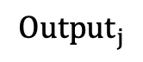

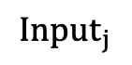


How do we fit a neural network model? Say we have a bunch of data
We need to find weights for the network (and also the “b” shift values)
$$σ$$
Squared Error:
(1 – 0.7)² = 0.09
0
1
24
69
32
2
42
99
93
29
$$σ$$
$$σ$$
$$σ$$
$$σ$$
0.7
$$σ$$
$$σ$$
$$Output_{j}$$
$$σ$$
$$σ$$
$$σ$$
$$Input_{j}$$

Slide 25
How do we fit a neural network model? Say we have a bunch of data
We need to find weights for the network (and also the “b” shift values)
$$σ$$
Squared Error:
(1 – 0.8)² = 0.04
30
32
31
40
90
91
2
4
82
9
$$σ$$
$$σ$$
$$σ$$
$$σ$$
0.8
$$σ$$
$$σ$$
$$Output_{j}$$
$$σ$$
$$σ$$
$$σ$$
$$Input_{j}$$

Slide 26
How do we fit a neural network model? Say we have a bunch of data
We need to find weights for the network (and also the “b” shift values)
$$σ$$
Squared Error:
(0 – 0.2)² = 0.04
99
99
98
45
52
3
25
99
98
93
$$σ$$
$$σ$$
$$σ$$
$$σ$$
0.2
$$σ$$
$$σ$$
$$Output_{j}$$
$$σ$$
$$σ$$
$$σ$$
$$Input_{j}$$

Slide 27

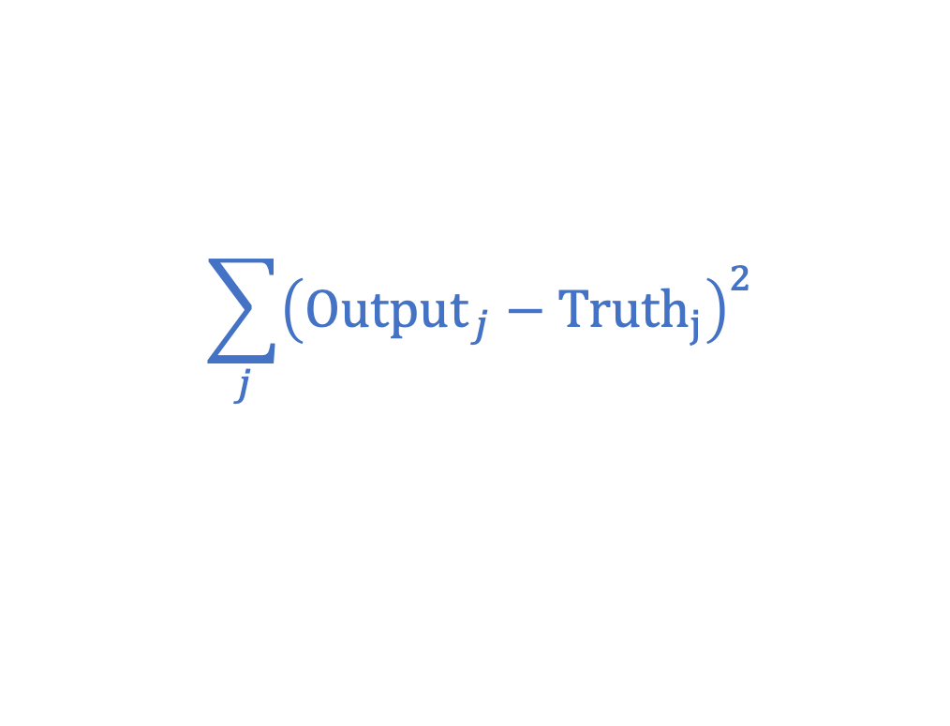


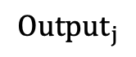


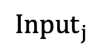




How do we fit a neural network model? Say we have a bunch of data
We need to find weights for the network (and also the “b” shift values)
$$σ$$
Find weights (and b’s) to minimize
$$σ$$
$$\sum_{j}{{\left({Output}_{j}−Truth_{j}\right)}^{2}}$$
$$σ$$
$$σ$$
$$σ$$
Predicted value between 0 and 1
1 if a cat
0 if not a cat
$$σ$$
$$σ$$
$$Output_{j}$$
$$σ$$
$$σ$$
$$σ$$
$$Input_{j}$$

Slide 28

How to use the model
Once we have the weights, try to predict if something new is a cat:
$$σ$$
30
32
31
40
90
91
2
4
82
9
$$σ$$
$$σ$$
$$σ$$
Probably a cat!
$$σ$$
0.99
$$σ$$
$$σ$$
$$Output_{j}$$
$$σ$$
$$σ$$
$$σ$$
$$Input_{j}$$

Slide 29
Detour: Optimization 101

Slide 30
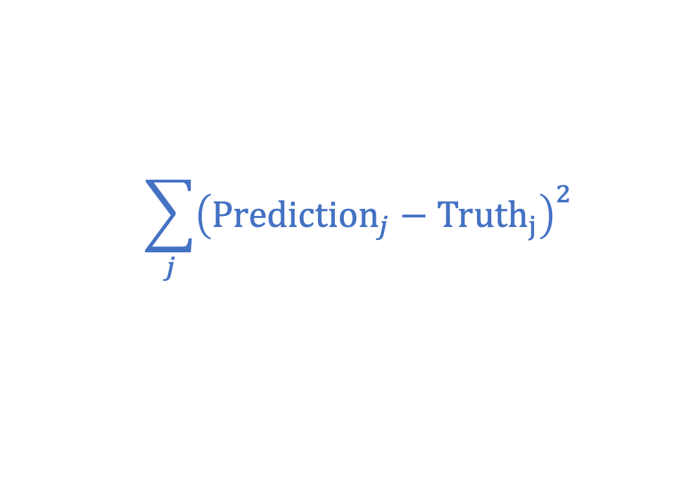
How do we minimize the error?
$$\sum_{j}{{\left({Prediction}_{j}−Truth_{j}\right)}^{2}}$$
Find (parameters of a model) to minimize
Search over all possible parameter settings?
That would take WAY TOO LONG!
Instead...

Slide 31
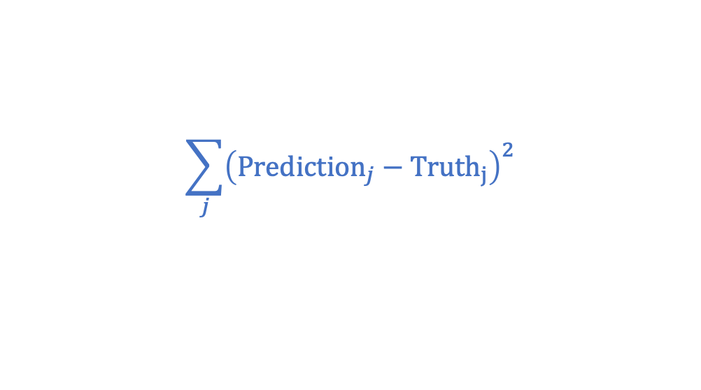
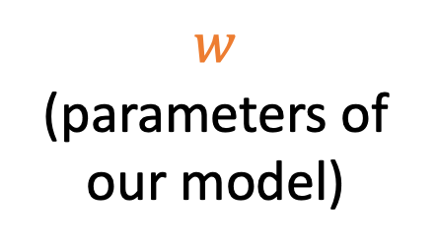
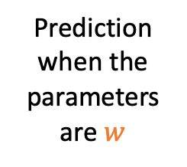
Gradient Descent
Prediction when the parameters are $w$
How can we find the minimum of this function?
$$\sum_{j}{{\left({Prediction}_{j}−Truth_{j}\right)}^{2}}$$
$w$
(parameters of our model)

Slide 32


Gradient Descent
How can we find the minimum of this function?
$$f(w)$$
$w$

Slide 33
Gradient Descent
How can we find the minimum of this function?
$$f(w)$$
$w$

Slide 34
Gradient Descent
How can we find the minimum of this function?
$$f(w)$$
$w$

Slide 35
Gradient Descent
How can we find the minimum of this function?
$$f(w)$$
$w$

Slide 36
Gradient Descent
How can we find the minimum of this function?
$$f(w)$$
$w$

Slide 37
Gradient Descent
How can we find the minimum of this function?
$$f(w)$$
$w$

Slide 38
Gradient Descent
How can we find the minimum of this function?
$$f(w)$$
Nowhere to go from here! I’m done!
$w$

Slide 39
Gradient Descent
*Disclaimer: lots of subtleties. How do we choose the step size? How do we pick our starting point? How do we decide/estimate what “downhill” is? Etc.
Gradient Descent is a fancy name for*
“walk downhill until you can’t anymore”
“Gradient” is from calculus: the direction of greatest change
“Descent” is “descent”

Slide 40
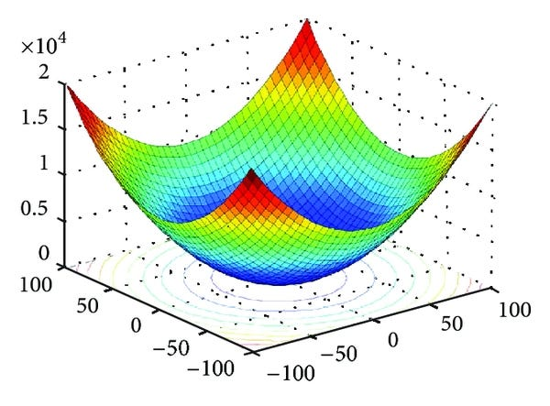


When does gradient descent work?
$$f(x)$$
$x$
These functions are convex (bowl-shaped).
Gradient descent always works!

Slide 41
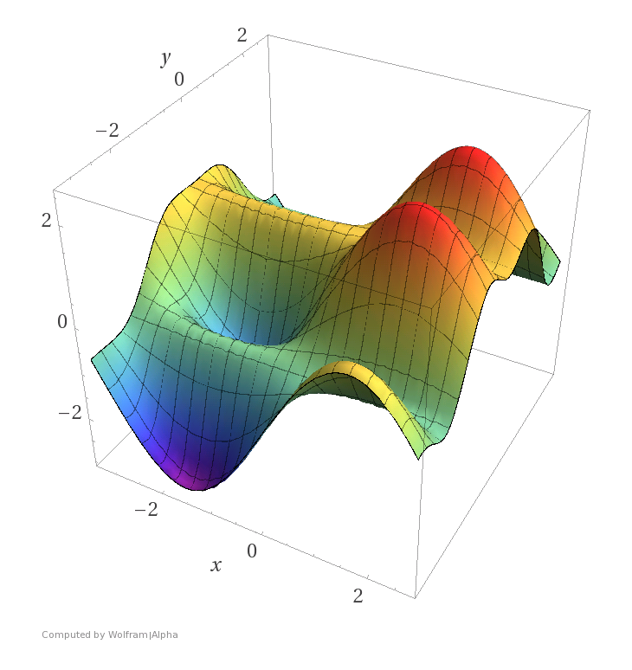
When does gradient descent work?
$$f(x)$$
$x$
These functions are non-convex.
Hmmm....

Slide 42


What about the functions we care about?
Regression: convex!
PCA/SVD: [can be made] convex!
Neural networks: non-convex

Slide 43

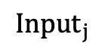






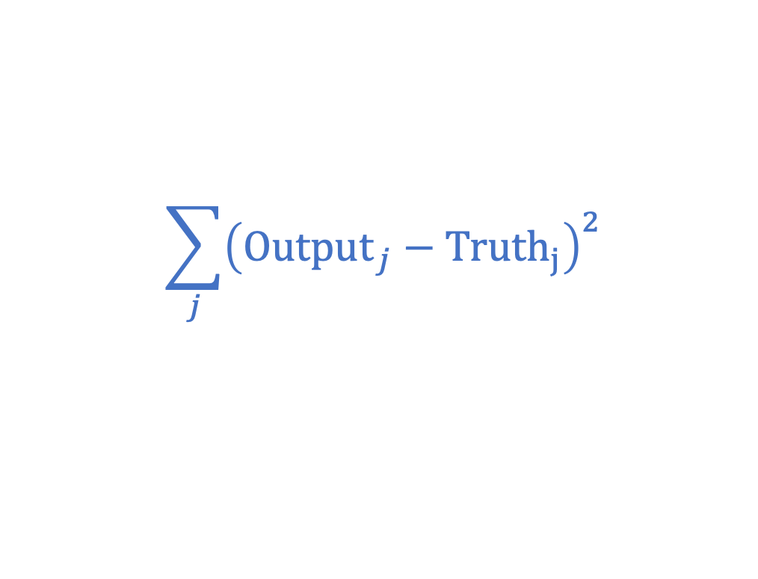



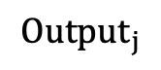
So...what do we do?
Find weights (and b’s) to minimize
$$\sum_{j}{{\left({Output}_{j}−Truth_{j}\right)}^{2}}$$
$$σ$$
$$σ$$
Predicted value between 0 and 1
1 if a cat
0 if not a cat
$$σ$$
$$σ$$
$$σ$$
$$σ$$
$$σ$$
$$Output_{j}$$
$$σ$$
$$σ$$
$$σ$$
$$Input_{j}$$
Essentially... just do gradient descent anyway and hope for the best!

Slide 44
Why does that work!?!??!
Why doesn’t gradient descent get “stuck” in a bad solution when trying to train a neural network?
We don’t really know!
This is the subject of (a lot of) ongoing research!

Slide 45
Neural Networks model the world
We need to answer:
What is the model?
How do we fit the model?
When is it reasonable? What assumptions does it impose?
How do we interpret the model once it is fit?
Network of neuroscience-inspired “neurons”, with weights and thresholds “b”
Gradient descent! (Walk downhill and hope for the best)

Slide 46
When is this model reasonable? What assumptions is it making?
Discuss!
Assumptions about the world
Assumptions about our data

Slide 47

Assumption about the world
The observables are enough
Can we tell if it’s a cat from the picture alone?
Age
Education
Browsing history
Facebook friends
...
Can we predict how much money you will make from your (other) observables?

Slide 48
Assumption about the world
The way in which observables determine outcomes can be captured by the model.
E.g., Regression can only capture linear functions.
What functions can neural networks capture?
Theorem: Any (continuous) function can be approximated by a (wide enough) neural network with one hidden layer.
So this is not a very strong assumption.

Slide 49
Assumption about the world
The non-convex landscape plays nice with our optimization algorithms...
Note: Researchers don’t really understand (yet) precisely what that means!

Slide 50
When is this model reasonable? What assumptions is it making?
Assumptions about the world
Assumptions about our data

Slide 51
Assumption: The data is representative
Say you train on this data...
But you actually care about a different population!
output
input

Slide 52
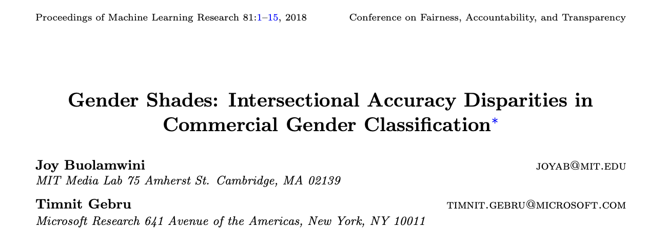
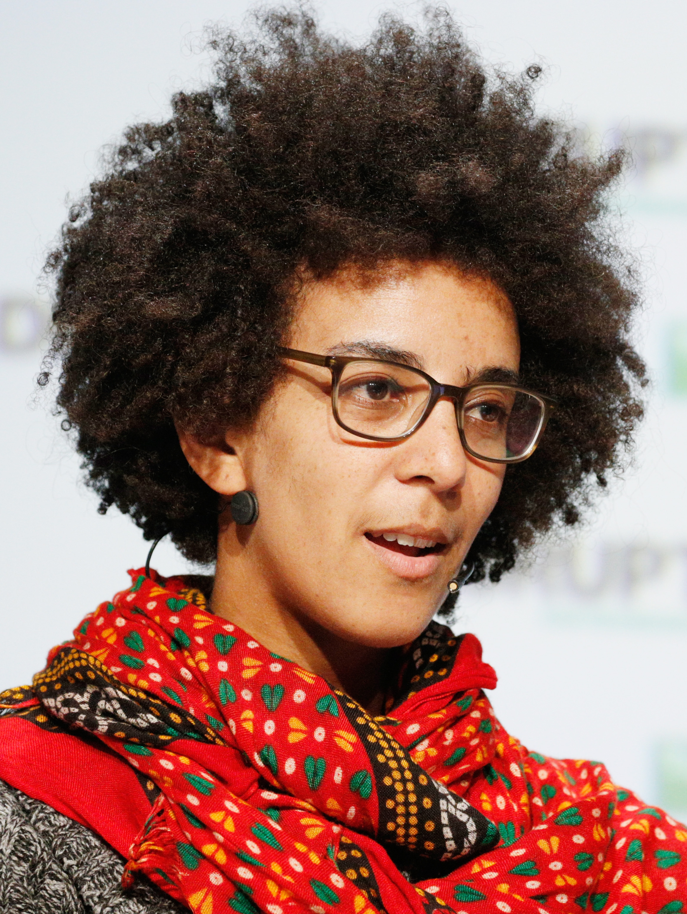

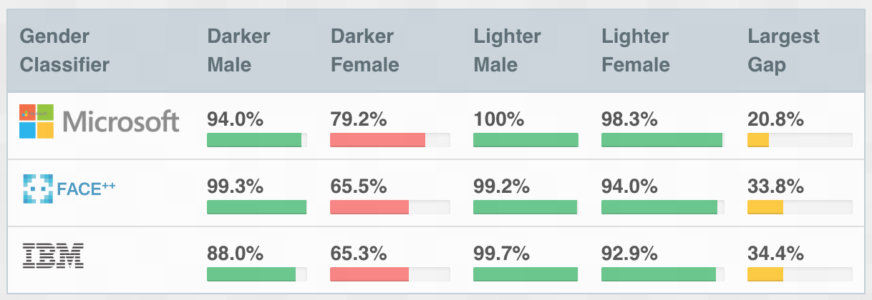
Assumption: the data is representative
Joy Buolaminwini
Timnit Gebru
Under-representation of darker-skinned women in datasets can lead to mis-classification.

Slide 53

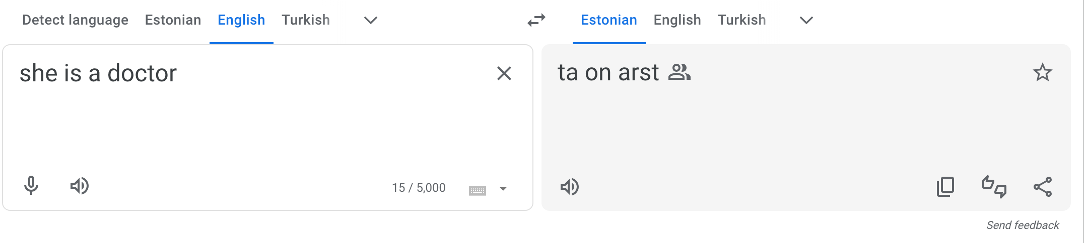
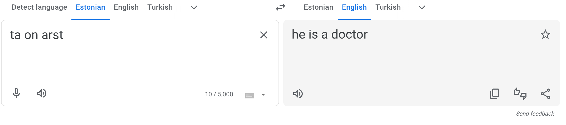
Assumption: The data is representative

Slide 54
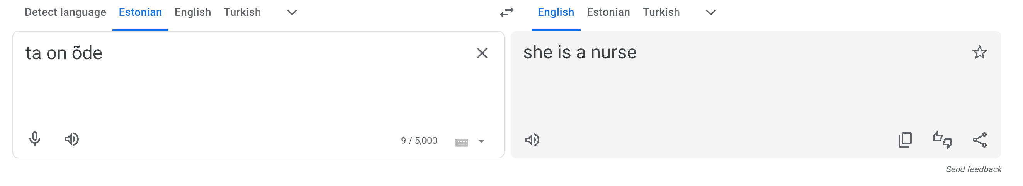
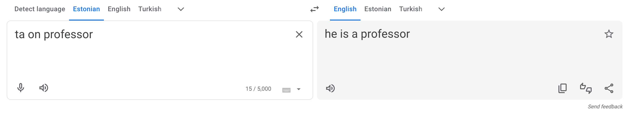
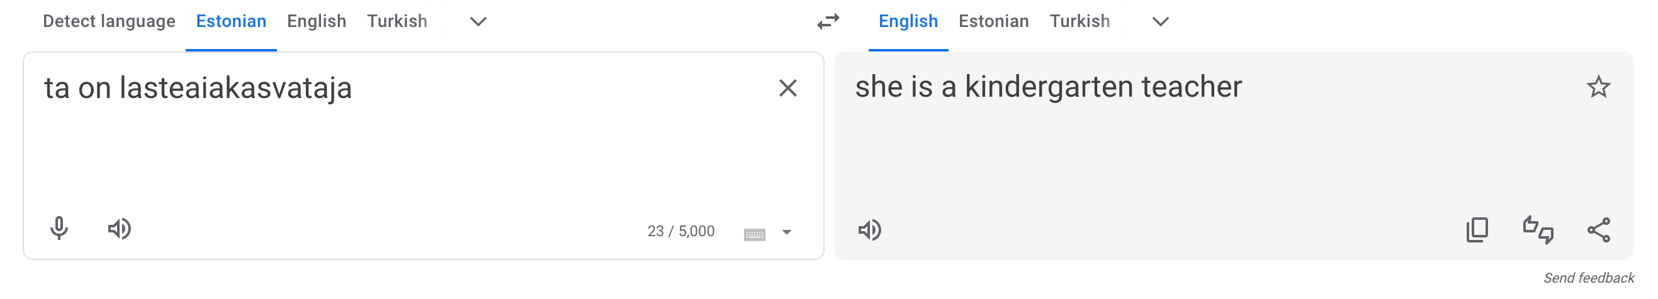
It seems there may not be a lot of female doctors or male nurses in Estonian/English
text corpora

Slide 55

Assumption: There is enough data
Machine learning works best when there is a LOT of data.
GPT-4 had 45 gigabytes of training data
Our biggest HW dataset (HW3, with over a million people in it) was about 60 megabytes = 0.06 gigabytes...

Slide 56
Detour: Overparameterization

Slide 57
What if there are more parameters than data points? Example: regression
Solve for a:
3a = 6
4a = 8
Solve for a and b:
3a = 6
2a + b = 5
Solve for a and b and c:
3a + c = 6
2a + b + 2c = 5
One parameter (variable)
Two data points (equations)
One solution!
a=2
Two parameters
Two data points
One solution!
a=2, b=1
Umm, infinitely many solutions?
a=1, b=-3, c=3
a=2, b=1, c=0
a=3, b=5, c=-3
a=4, b=9, c=-6
...
Three parameters
Two data points

Slide 58

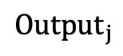


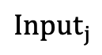







Overparameterized models
An NN can capture LOTS of different functions that “fit” the data.
Which is the “right” one?
output
Model prediction
$$σ$$
$$σ$$
$$σ$$
$$σ$$
$$σ$$
$$σ$$
$$σ$$
$$Output_{j}$$
$$σ$$
$$σ$$
$$Input_{j}$$
$$σ$$
So many parameters!
So expressive!
input

Slide 59
Overparameterized models
An NN can capture LOTS of different functions that “fit” the data.
Which is the “right” one?
This function fits the training data even better...
output
$$σ$$
$$σ$$
$$σ$$
$$σ$$
Model prediction
$$σ$$
$$σ$$
$$σ$$
$$Output_{j}$$
$$σ$$
$$σ$$
$$Input_{j}$$
$$σ$$
So many parameters!
So expressive!
input

Slide 60
Overparameterized models
An NN can capture LOTS of different functions that “fit” the data.
Which is the “right” one?
This function fits the training data even better...
output
$$σ$$
$$σ$$
$$σ$$
$$σ$$
$$σ$$
$$σ$$
$$σ$$
$$Output_{j}$$
$$σ$$
...but seems like it would not do well on new test data.
$$σ$$
$$Input_{j}$$
$$σ$$
Intuition: A model with lots of parameters can “overfit” to training data.
So many parameters!
So expressive!
input

Slide 61
What we would expect
Training data: data we use to fit the model.
Test data: fresh data that we use to evaluate the model.
Error
Error on test data
Sweet Spot
“Overfitting”
Error on training data
Model Complexity
(number of parameters)

Slide 62
What can actually happen for NNs “Double Descent”
Error
“classical” regime
“modern” regime
If you massively
over-parameterize...
...good things happen?
Error on test data
Error on training data
Model Complexity
(number of parameters)
The model is “expressive” enough to capture the training data very well

Slide 63
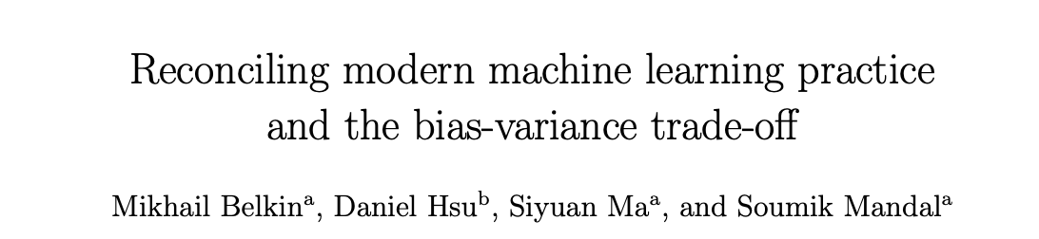
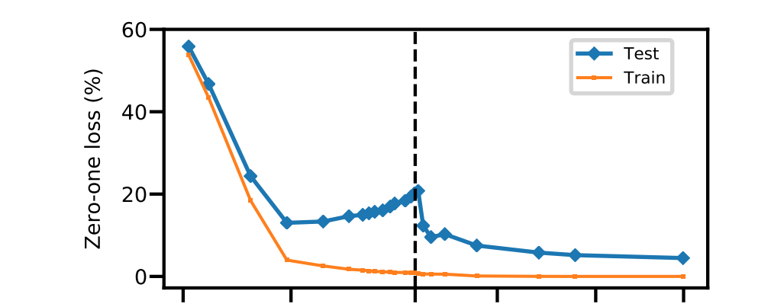



Example Digit classification

Slide 64


Related phenomenon
ML researchers have used the same datasets (like ImageNet) for decades.
Have their solutions “overfit” to this particular dataset?
Is that a problem?
Yes
Maybe not?
ImageNet: Labeled pictures of lots of different things

Slide 65

The line y=x. If there were no over-fitting, all the blue dots would lie on this line.
Each of these dots is a model from a published ML paper.
(The red line is a line-of-best-fit – aka regression!)
The red line has a pretty large slope – that suggests that even though the models have “overfit,” they are still learning something!

Slide 66
Take-aways
Neural networks (and related ML models) work well when they are really over-parameterized.
This should be surprising! Isn’t over-fitting bad?
Why this happens is the subject of a lot of ongoing research!
Back to assumptions about the world/our data...
We are implicitly relying on an assumption like “the world/our data/gradient descent/neural networks work together in such a way that over-parameterization can be good.”
But we don’t really understand (yet) what that means.

Slide 67
Neural Networks model the world
We need to answer:
What is the model?
How do we fit the model?
When is it reasonable? What assumptions does it impose?
How do we interpret the model once it is fit?
Network of neuroscience-inspired “neurons”, with weights and thresholds “b”
Gradient descent! (Walk downhill and hope for the best)
The observables predict what we want; We have enough data; The data is ”representative” of the population we care above; And some other things we don’t fully understand...

Slide 68
How do we interpret the model?
Answer 1:
We don’t!
This is just for prediction!

Slide 69
How do we interpret the model?
Answer 1: We don’t.
Answer 2: We don’t, but... We can embed it in a larger model, which we can interpret.

Slide 70

Example
Demirer did his BA and MA at Koç

Slide 71

Main idea of the paper
Say we are in a setting where there lots of observables
A model that uses all these observables as variables will be over-parameterized.
Sounds like a job for Neural Networks!
But...we have a causal question...
What is the effect of
college on earnings?
This government program on outcomes?
Etc?
...Wait, aren’t there more of you?
Age
Education
Browsing history
Facebook friends
Every purchase ever made
...
Age
Education
Browsing history
Facebook friends
Every purchase ever made
...

Slide 72











The model
$\vec{X_{j}}$ are all of the observables we want to “control for”
Blast from the past! $m\left(\vec{X_{j}}\right)$ is the propensity score!
Something in between!
Regression!
Neural Networks!
$$Y_{j}=bD_{j}+g\left(\vec{X_{j}}\right)$$
$$D_{j}$$
$$σ$$
$$Y_{j}=a+bD_{j}+\vec{c}⋅\vec{X_{j}}$$
$$σ$$
$$σ$$
$$σ$$
$$σ$$
$$Y_{j}$$
$$D_{j}=m\left(\vec{X_{j}}\right)$$
$$\vec{X_{j}}$$
$$σ$$
$$σ$$
$$σ$$
$$σ$$
$b$ is the
“effect of $D_{j}$ on $Y_{j}$”
(if we believe the model)
$b$ is the
“effect of $D_{j}$ on $Y_{j}$”
(if we believe the model)
$$σ$$
Can interpret parameters of the model
What the heck does “the weight between these two neurons” mean??
Can fit the model in a way that will “generalize” to test data
Use a neural network to “learn” the functions g and m.

Slide 73
























In a bit more detail Split the sample in two
Input we care about:
$D_{j}$ = “Did you participate in this program?”
Output we care about:
$Y_{j}$ = “Retirement savings” (say)
All the other stuff: $\vec{X_{j}}$
Age
Education
Browsing history
Facebook friends
Every purchase ever made
...
Sample 1:
Sample 2:
$$σ$$
$$σ$$
$$σ$$
$$σ$$
$$σ$$
$$σ$$
$$\vec{X_{j}}$$
$$σ$$
$$σ$$
$$Y_{j}$$
$$\vec{X_{j}}$$
$$σ$$
$$σ$$
$$D_{j}$$
$$σ$$
$$σ$$
$$σ$$
$$σ$$
$$σ$$
$$σ$$
$$σ$$
$$σ$$
$$σ$$
$$σ$$
Train a NN to predict $Y_{j}$ from $\vec{X_{j}}$. Call that function $g$.
Train a second NN to predict $D_{j}$ from $\vec{X_{j}}$. Call that function $m$.

Slide 74
Application: retirement savings There are also other applications in the paper
In the USA, some employers provide access to tax-preferred retirement savings accounts known as 401(k).
The US spends lots of money subsidizing these and other similar programs (over $100 billion in 2023).
Question: Does access to 401(k)s actually increase savings?

Slide 75

What do we see?
$D_{j}$: Whether someone had access to a 401(k)
$Y_{j}$: How much they saved for retirement
$\vec{X_{j}}$: Other things:
age,
income,
family size,
years of education,
a married indicator,
a two-earner status indicator,
a defined benefit pension status indicator,
an IRA participation indicator
a home-ownership indicator.
Observational Comparison says:
“The effect of having access to a 401(k) on savings is about $19,000”
(but of course we don’t necessarily believe that number)

Slide 76
Ideally...do an RCT!
Randomly give people access to 401(k) plans.
See if the people who got access saved more.
As usual, can’t do that ☹

Slide 77
Next ideally...find a natural experiment?
Argue that when the program started (1980s), people didn’t think about 401(k)’s when choosing an employer.
So we hope that whether or not someone has access to a 401(k) in 1980 is basically random...
...or is it?!?!?!?!

Slide 78

Some evidence of non-randomness
Higher income folks are more likely to be eligible and to participate in 401(k)s
Bad news for our natural experiment ☹

Slide 79

Hope that if we control for income it will be fine...
how much folks without access to 401(k) save
how much folks with
access to 401(k) save
Estimate: The effect of access to 401(k) on savings is about $11,000.

Slide 80

But! We can also use ML to additionally “control” for all of the things
Estimate: The effect of access to 401(k) on savings is about $7000-$8000.

Slide 81
How do we interpret the model?
Answer 1: We don’t.
Answer 2: We don’t, but... We can embed it in a larger model, which we can interpret.
Answer 3: We don’t, but... We can use this model to learn something we can interpret.

Slide 82

Example
Quarterly Journal of Economics, 2018

Slide 83
Context: Bail decisions in New York City
When awaiting trial, judges decide whether defendants will wait in jail or wait at home.
A few classes ago we saw a natural experiment about this:
Which judge you are assigned to is random-ish
Conclude that it seems pretty bad to be detained
More likely to plead guilty
Less likely to be employed a few years out

Slide 84

This paper Could/Should we replace bail judges with ML?
Possible benefits?
Possible risks?

Slide 85










How can we tell if we could/should?
* This paper doesn’t actually use an NN, they use a different ML model called ”Gradient Boosted Decision Trees.”
Try 1:
Given data on people released on bail, learn*:
$$σ$$
$$σ$$
$$σ$$
Input: What we see about the person
$$σ$$
$$σ$$
Output: did they re-offend?
$$σ$$
$$σ$$
$$σ$$
$$σ$$
$$σ$$
Using the trained model on holdout data, pretend we released someone if their “Output” is above some threshold.
See if this does better than human judges.
Issues with this?

Slide 86
Possible issues
Selection problem:
We only see data for people who are released.
This sample might not be representative of the population we care about.
When evaluating the ML judge, we can’t see what would have happened for folks who the human judge didn’t release.
What do we mean by “do better than human judges”?
We don’t know what human judges are actually optimizing for.
Maybe that’s good – we can optimize for the “right” thing while human judges might optimize for the “wrong” thing(s).
Maybe that’s bad – maybe we can’t quantify “right” and “wrong.”

Slide 87

Addressing the Selection Problem
Detain them!
Release them!
Release them!
Detain them!
ML “judge”
Human judge
ML “judge”
Human judge
We don’t know what would have happened for this particular person...
But! We can use the “random judge” instrument to see what would have happened to people like them!
This is fine: we know what would have happened had the ML judge “released” them.

Slide 88
Addressing the “what does better mean” problem
This is more philosophical.
But we can try various definitions of “better.”
Better = “less recidivism”
Better = “less racial bias”
Better = “don’t lock up folks with families/kids/jobs”
Spoiler alert: On all of these, the paper finds that the ML “judges” do “better” (or at least not “worse”).
I can do a better job than you!
Detain the AI!
ML “judge”
Human judge

Slide 89
Let’s see what happens!

Slide 90
Data and context
New York City
All arrests from November 1, 2008 to November 1, 2013
758,027 subject to a pre-trial release decision
Split sample into training, holdout and a lock-box subsample
What we train the model on
What we use to check that the model is well-trained, and to compare to the ML
They saved this to replicate all of their results after the paper was accepted. Responsible data science!

Slide 91
As usual, “Pretend it’s an RCT” won’t work
In this data, judges are more likely to detain:
Folks arrested for more violent crimes
Folks with a longer criminal record
Black males
People arrested in Manhattan
...

Slide 92


Release is nonrandom: Demographics
Judges are more likely to detain:
Males
Black people
Folks arrested in Manhattan

Slide 93

Release is nonrandom: Arrest charge
Judges are more likely to detain people arrested for more violent crimes.

Slide 94

Release is nonrandom: prior record
Judges are more likely to detain folks with a longer criminal history.
FTA: failure to appear (in court)

Slide 95










How do we train the model? On the training data...
$$σ$$
Inputs:
Age (but not race or gender)
Characteristics of the defendant’s current case*
Prior criminal record*
$$σ$$
$$σ$$
$$σ$$
$$σ$$
Output: did they re-offend?
$$σ$$
$$σ$$
$$σ$$
$$σ$$
$$σ$$
*All the variables we just saw
The trained model is definitely doing something fancier than regression.
A regression on these observables only captures about half the variance in the trained model.

Slide 96

How does the algorithm compare to the judges?
Judges release 46% of the defendants that the algorithm predicts are in the top 1% of risk
Judges release 80-90% of the defendants that the algorithm predicts are in the bottom 1% of risk
Detain the AI!
At least you’re more likely to release less risky people!
ML “judge”
Human judge

Slide 97

Does the algorithm predict recidivism well? In the hold-out sample
Looks pretty good!
The predictions lie close to the line y=x.
However, this is only evaluated on the population that the human judges released...
Let’s redo this using the judge leniency instrument.

Slide 98

Does the algorithm predict recidivism well? Using the hold-out sample, but controlling for “leniency” of judges
The algorithm is trained on “Q1” (people released by most lenient judges).
It looks like it still performs well on harsher judges (Q2-Q5).
That’s good!
If judges are picking up on something that the ML is not, then we expect prediction would get worse as we go to harsher judges.

Slide 99

Can ML do better than the judges? At reducing recidivism
Say we want to decrease recidivism.
Option 1: Use only the harsher judges.
Option 2: Use ML with a higher threshold
Option 2 seems better:
To achieve the same decrease in crime, the ML would jail fewer people.
Option 1
Option 2

Slide 100
Can ML do better than the judges? At reducing recidivism
Say we want to decrease recidivism.
Option 1: Use only the harsher judges.
Option 2: Use ML with a higher threshold
Option 2 seems better:
To achieve the same decrease in crime, the ML would jail fewer people.
To achieve the number of jailed people, the algorithm reduces crime more.
Option 1
Option 2

Slide 101

Do judges do better on some other dimension? Example: race
Same exercise
It looks like the ML does better:
To get the same reduction in crime, ML jails fewer Black defendants.
To jail the same amount (including of Black defendants), the algorithm reduces crime more.
Option 1: use harsher judges
Option 2: use ML with harsher thresholds

Slide 102
Summary
This paper finds that ML can do better than humans as bail judges.
Both better at reducing crime, and also on various notions of “fairness”
Either ML is good, or human bail judges could be better...
I’m awesome!
Technically, I’m a cat.
ML “judge”
Human judge

Slide 103
Neural Networks model the world
We need to answer:
What is the model?
How do we fit the model?
When is it reasonable? What assumptions does it impose?
How do we interpret the model once it is fit?
Network of neuroscience-inspired “neurons”, with weights and thresholds “b”
Gradient descent! (Walk downhill and hope for the best)
The observables predict what we want; We have enough data; The data is ”representative” of the population we care above; And some other things we don’t fully understand...
We don’t!
We use ML as one part of a model that we can interpret
We use ML to predict something that we can interpret (probability of re-offense)
...

Slide 104
Wrap-Up

Slide 105
Recap! Neural Networks
What is the model?
How do we fit the model?
When is it reasonable? What assumptions does it impose?
How do we interpret the model once it is fit?
Network of neuroscience-inspired “neurons”, with weights and thresholds “b”
Gradient descent! (Walk downhill and hope for the best)
The observables predict what we want; We have enough data; The data is ”representative” of the population we care above; And some other things we don’t fully understand...
We don’t!
We use ML as one part of a model that we can interpret
We use ML to predict something that we can interpret (probability of re-offense)
...

Slide 106
Coming up...
We’ll get you feedback on your project proposals soon!
Next time: Prepare a short (<5 minute) presentation to pitch your project.
You should have a title slide and two other slides
See Project Guidelines document for more guidance
PRACTICE in order to stay within time!!!!
Also next time: Sparsity and other structural assumptions!
See you next week!
Except that Isaac will be in the UK

